Slide 1
Computers and Random Numbers
Andrew Ross
Math Dept., Eastern Michigan Univ.
2009-04-14

Slide 2
Why use random numbers?
Simulating random events:
arrivals to a queueing system
Poker, backgammon, etc.
Doing deterministic computations (like integrals)
Cryptography

Slide 3
How Random do you want?
Simulations: want them to be reproducible
Computations: want them to be reproducible
Cryptology: NO NO NO NO NO!

Slide 4
Cryptology
Start with a message bit string (“plaintext”)
01001010101011110
Use a key
00101001101101000
Encrypt the plaintext using the key w/XOR
01100011000110110
Decrypt the same way:
01001010101011110

Slide 5
How random is the key?
If it’s not truly random, it has patterns.
Patterns can be figured out.
Classic example:
Base your random numbers on current time?
Does make them more random,
But also easier to guess.

Slide 6
Encryption vs. Compression
Compression: find patterns in data, express them more succinctly
Results should have no patterns left
If there are patterns left, could compress more.
Encryption: remove patterns from data
Should you encrypt first then compress, or vice versa?

Slide 7
Sources of True Randomness
1955, RAND Corp:
A Million Random Digits with 100,000 Normal Deviates
Used electronic noise for randomness
More recently:
Webcams that watch lava lamps,
Resulting video run through data compression algorithm

Slide 8
Making an Unfair Coin Fair
Suppose each flip is independent of others
Pr(heads) = p
Flip twice. If results are:
HT, count it as “heads”, Pr = p*(1-p)
TH, count it as “tails” Pr = (1-p)*p
HH or TT, ignore the result and flip BOTH again.
Not the same as: if HH or TT, flip second coin again.

Slide 9
Good Classroom Random Numbers
Coin flipping/dice rolling, obviously
If you need a lot of random numbers, consider using a cup to keep dice contained, not falling all over the floor.
TI-83/84: Math menu->Probability->Random
But, might all get the same values!
Excel =rand(), uniform between 0 and 1
Last few digits of:
Soc.Security #
Student ID#
Credit Card #
Drivers’ License #
Tell students to pick one of those 4 without revealing which one they picked.
Less privacy concern:
Serial # of dollar bills
Serial # of calculator or cell phone (look at the back)
Random page# of a textbook (only the last 2 digits)

Slide 10
Pseudo-Random Number Generation
PRNG
Getting computers (which should be deterministic) to act random.
Insert joke about Microsoft products here.
Used for simulation, etc.
Goals:
Easy to compute (fast, low memory)
Repetition cycle very long
Independent from sample to sample
Usually, generate Uniform(0,1) values

Slide 11
100 U(0,1) x-y pairs

Slide 12
Most Common PRNG
Would you jump off a bridge if everyone else was doing it?
Linear-Congruential Generator (LCG), e.g.
X(n+1) =
(1664525*X(n)+1013904223)mod 2^32
Various guidelines for what numbers to use.
Where to start? X(0)=what?
Starting value is called “seed” (not just LCG)

Slide 13
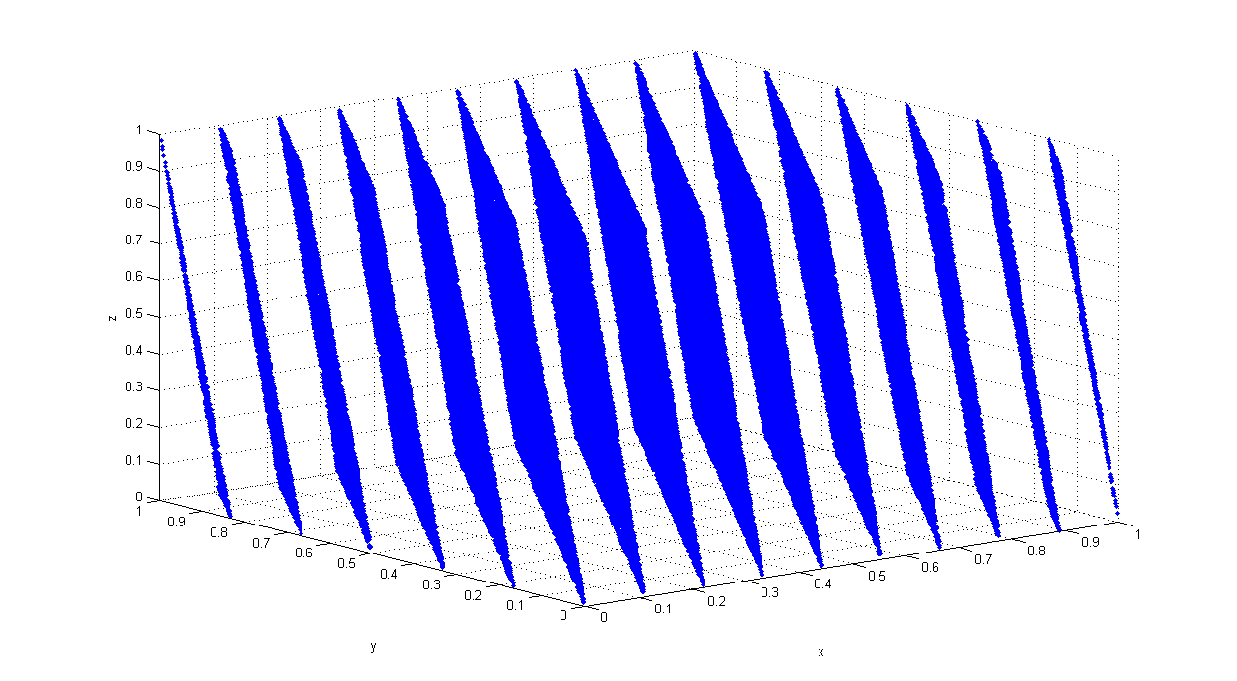
Why not LCG?
http://en.wikipedia.org/wiki/RANDU

Slide 14
Better options
Mersenne Twister, 1997
Period of 2^19937-1 (approx. 10^6001)
Default in R, Matlab, Python, Ruby
http://en.wikipedia.org/wiki/Mersenne_twister
Excel: Wichman and Hill algorithm
Bug in Excel 2003: sometimes gave negative numbers! Patch available.

Slide 15
Does it really matter?
I’ve had a backgammon simulation fail due to a bad PRNG
A physics paper about how 5 different PRNGs give the wrong answer to a problem.
Physical Review Letters (Vol 69 issue 23), pgs 3382 - 3384 (1992) Monte Carlo simulations: Hidden errors from ‘‘good’’ random number generators; Alan M. Ferrenberg, D. P. Landau, Y. Joanna Wong
Many other such papers since then.

Slide 16
Seed values
All PRNGs need them, not just LCG
Instead of storing the whole set of PRNs, just store the seed that generated them
All TI-83/84’s start with the same seed when they come from the factory
Some people set the seed based on the current clock time, but:
Hard to reproduce,
Doesn’t actually make it any more random
Pacman, other early video games used the same seed each time—ghosts move in the same way!

Slide 17
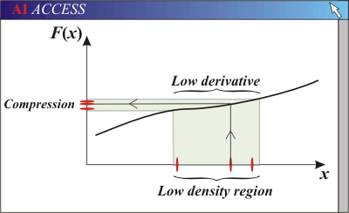
From U(0,1) to other distributions
X = F⁻¹(U)
“Probability Integral Transform”

Slide 18
In particular
Exponential: X=-ln(U) / lambda
Normal (chintzy way)
X = U₁ + U₂ + … +U₁₂
Normal (in Excel)
X = norminv(rand(),0,1)*sigma + mu
Also easy: Triangle, Pareto, Weibull, Laplace, Geometric, Bernoulli, Cauchy
Medium: Binomial, Poisson (“for-loops”)
Harder: Beta, Gamma w/shape param noninteger

Slide 19
Clever idea
1-U is also Uniform(0,1)
It’s big if U is small, and vice versa
Run a simulation using U values, then re-run using 1-U values
Answers will tend to be negatively correlated
Average them—get a reduced variance
“Antithetic random variates”

